Slide 1
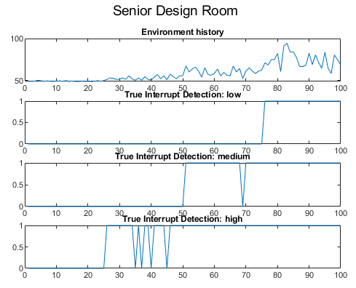
False and True Detection Rates
Example
Previous knowledge of whether each data point is an interrupt is key for False Detection Rates.
Known:
First 25 are ‘non-interrupt’ sound levels
25-50 are ‘quiet interrupts’ or high sensitivity level sounds
50-75 are medium level interrupts
75-100 are loud or ‘low sensitivity’ interrupts

Slide 2
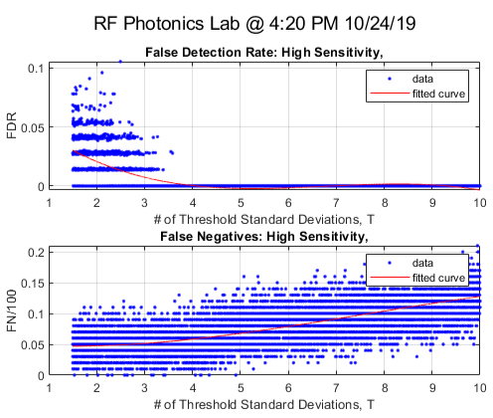
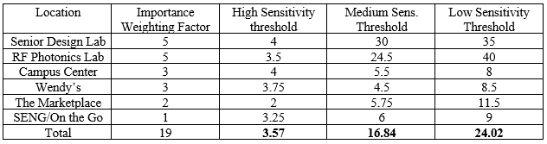
Optimization
For many trials, False Detection Rate is compared with Threshold standard deviation number.
Weighted approach to defining a static number of standard deviation to each threshold level.

Slide 3
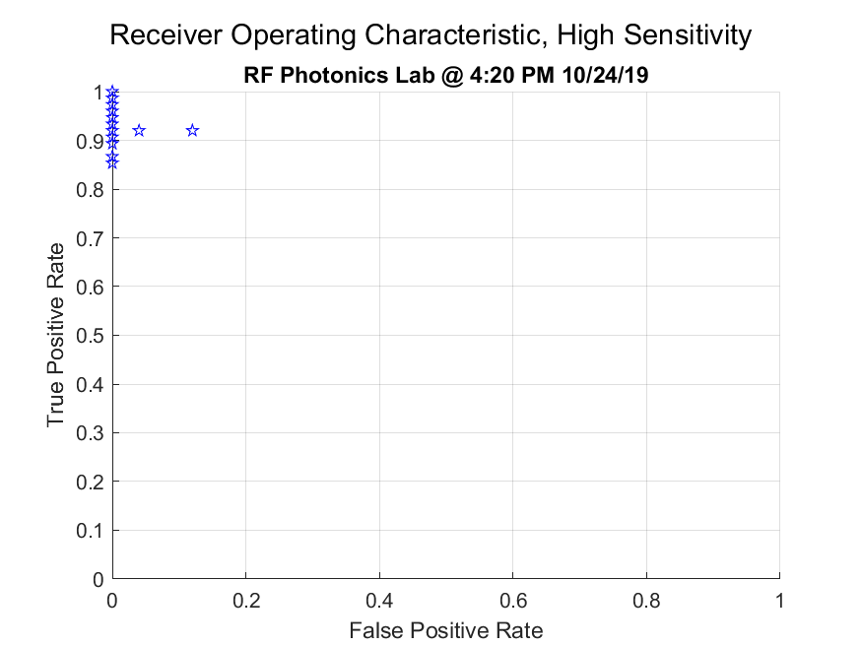
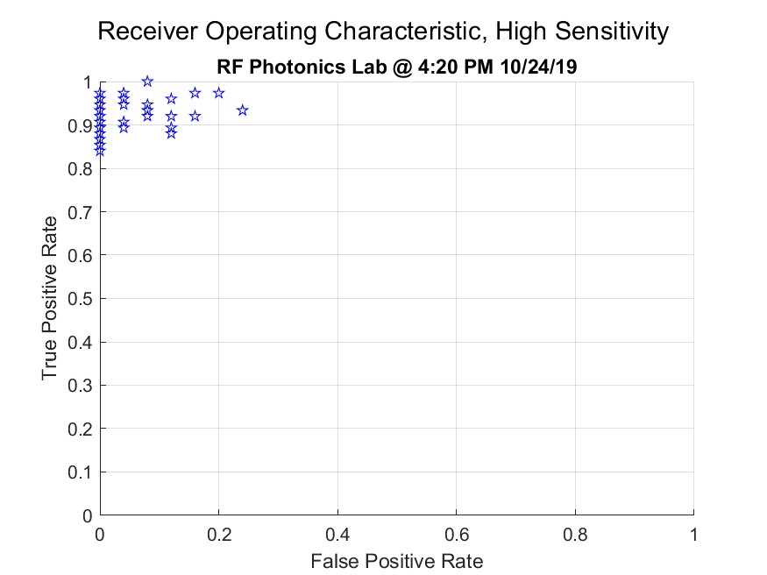
Receiver Operating Characteristic
Environment-Tuned
Standard Performance

Slide 4
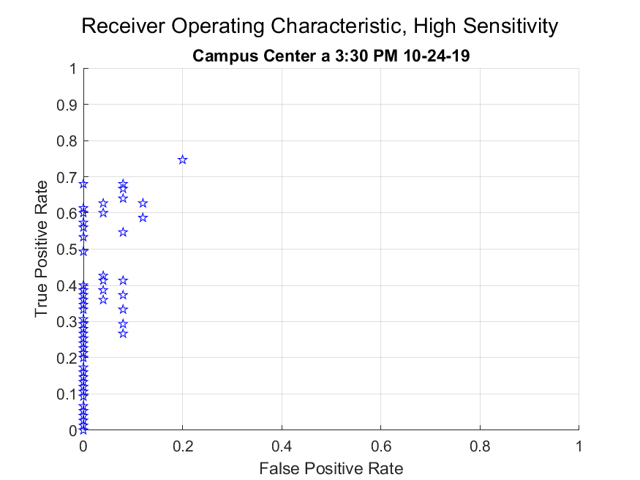
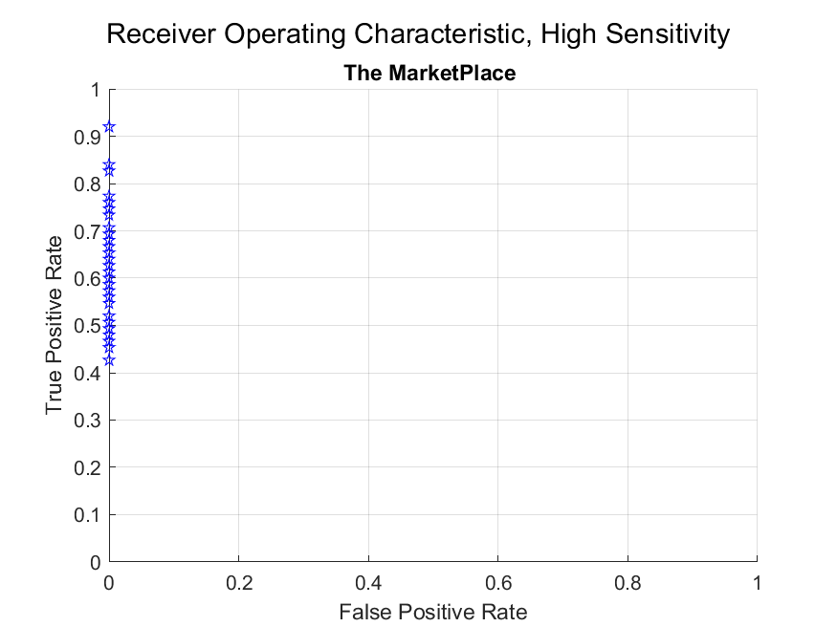
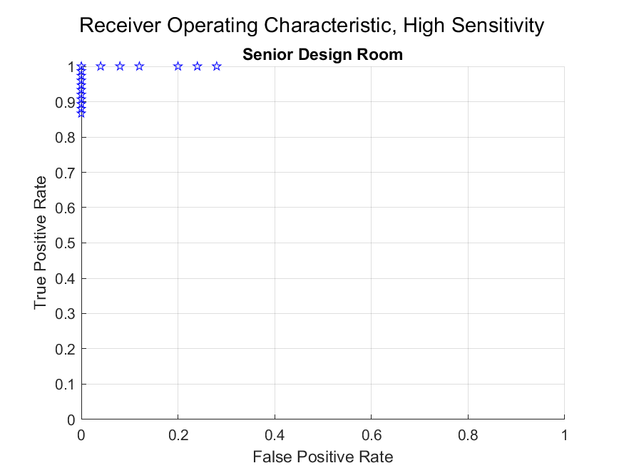
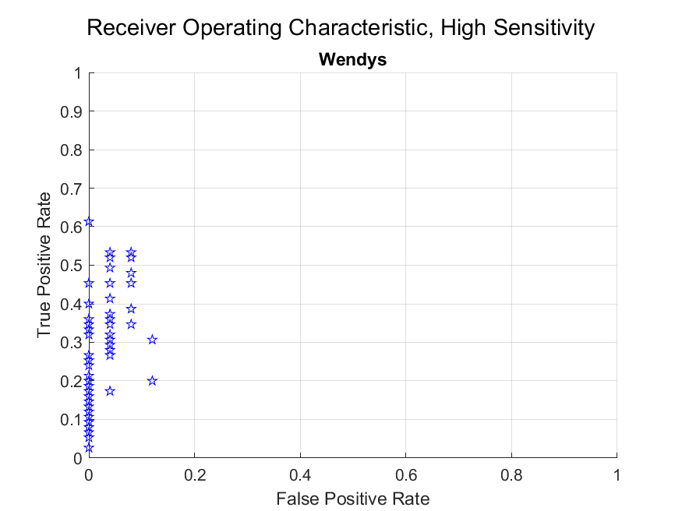
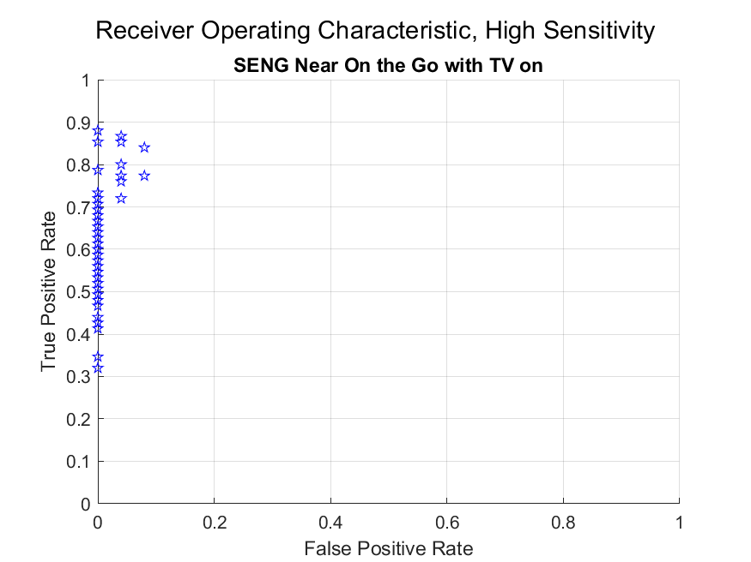
Standard - High Sensitivity Performance

Slide 5
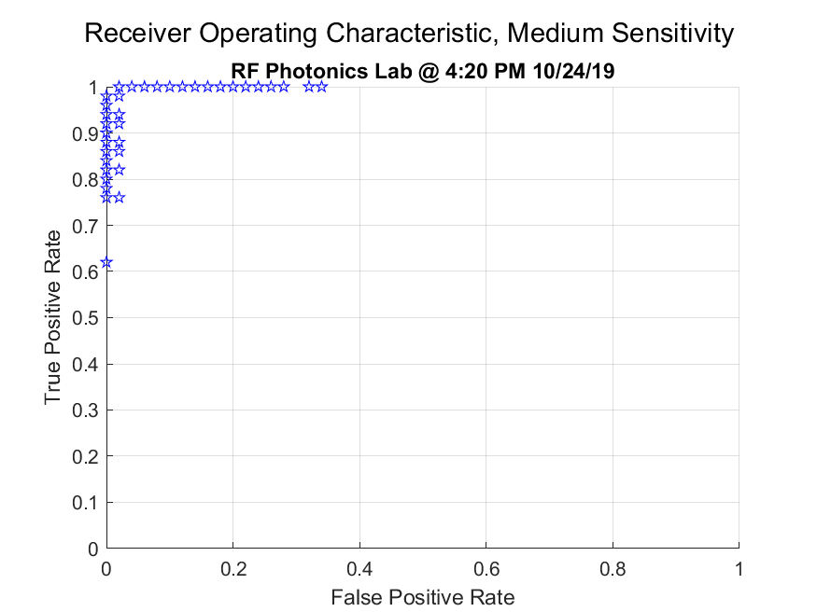
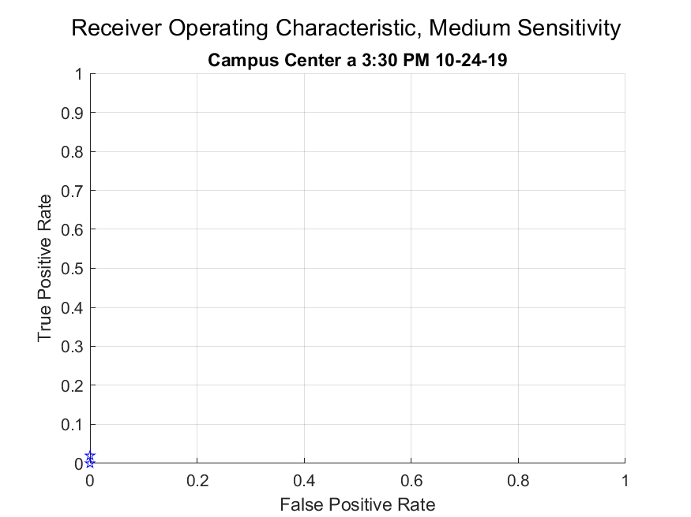
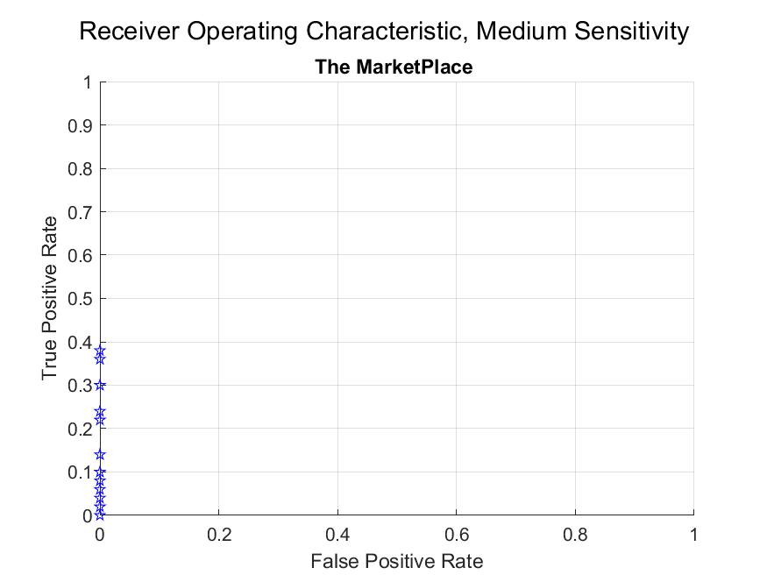
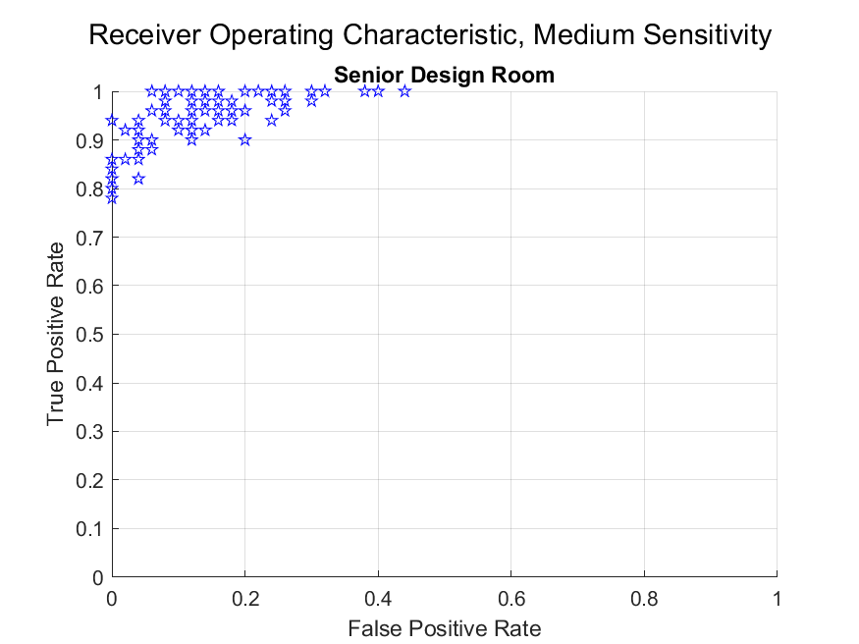
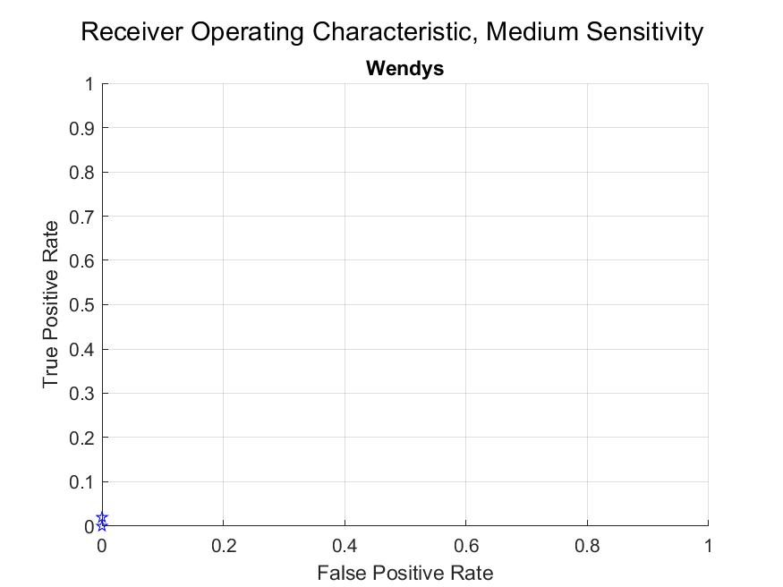
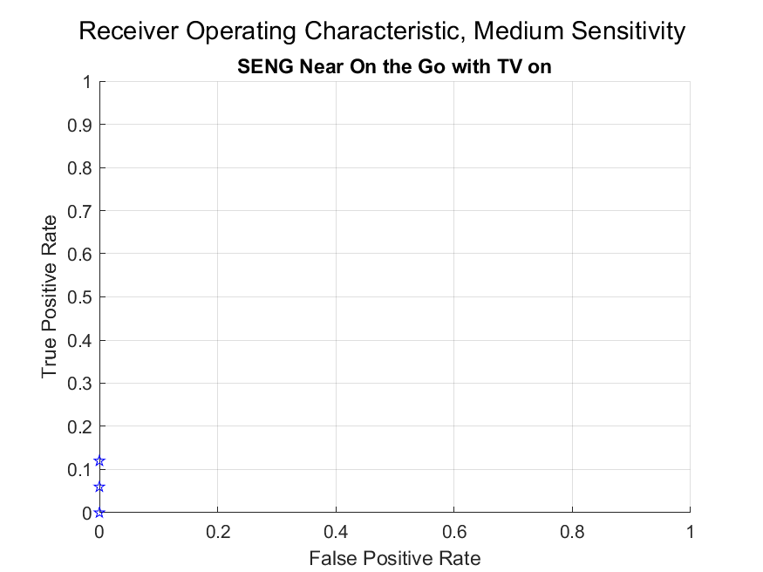
Standard – Medium Sensitivity Performance

Slide 6
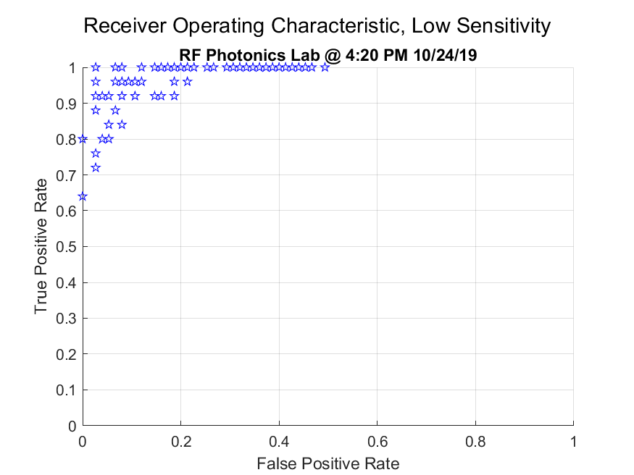
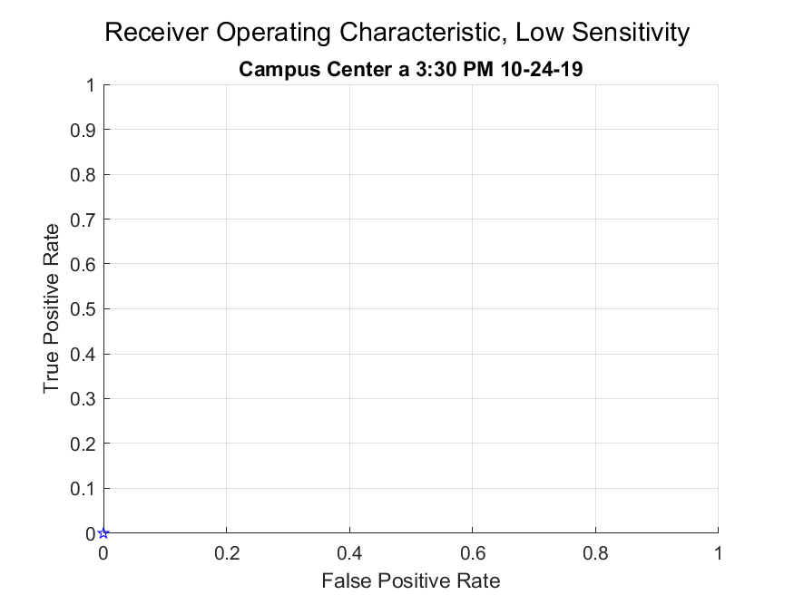
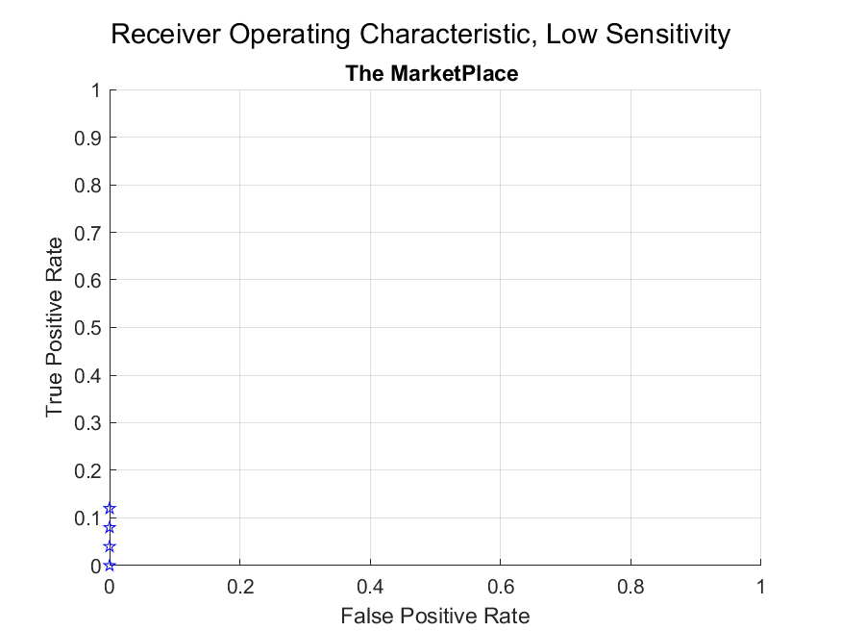
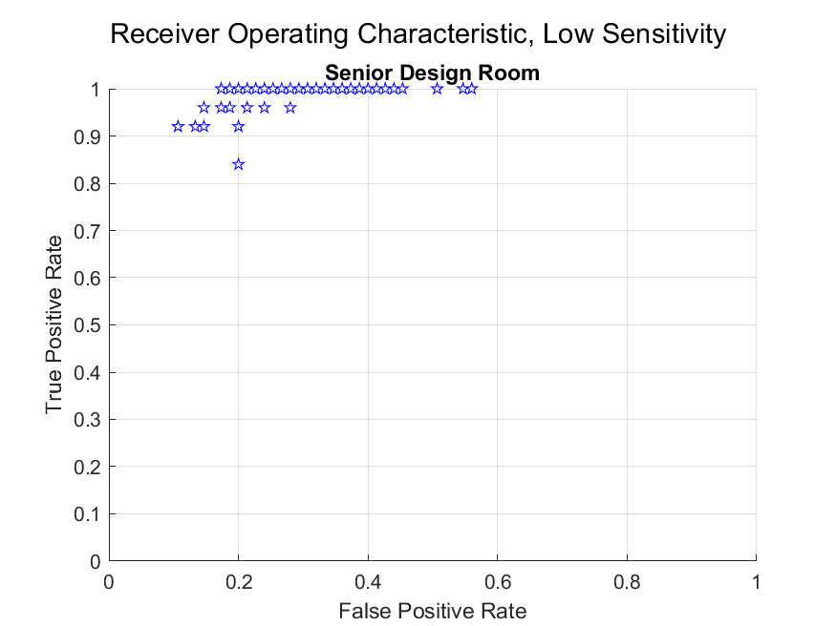
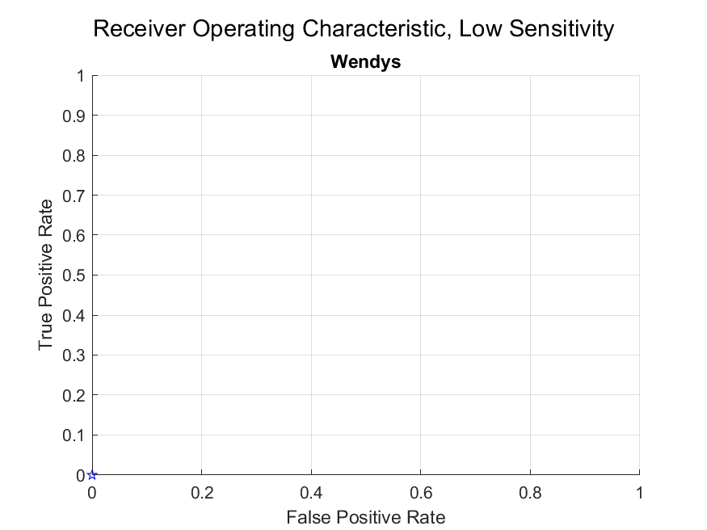
Standard - Low Sensitivity Performance

Slide 7
Tuning Performance in a fully integrated AAE
Tests
Possibly… research
To determine the threshold number of standard deviations for each setting and in the environments most similar to where the AAE will be used.
How to ensure performance in both loud and fluctuating environments and quiet and consistent environments?
Consider a non-static approach
Categories of environments for AAE to behave differently in
Higher order curve-fitting for standard deviation number approach
→Avoiding tradeoffs in performance in different environments

